Slide 1
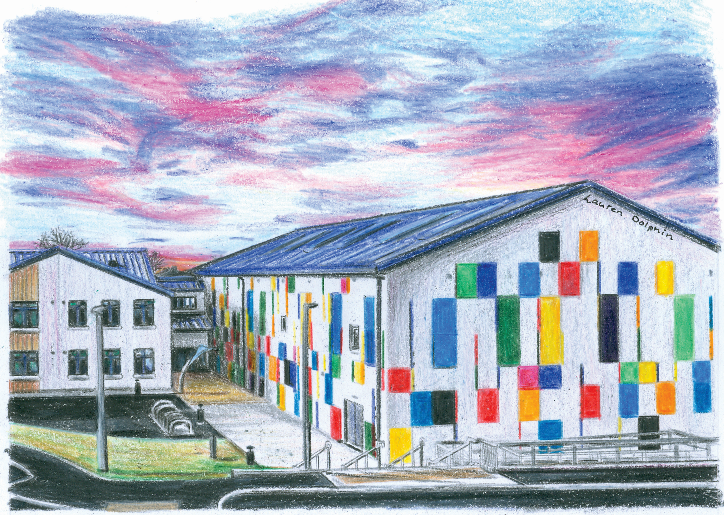
St. Raphael’s College 1st Year Information Evening 2020

Slide 2
Tonight’s Agenda
Introduction & Welcome
Information on Parents’ Handbook
Return to School Protocols
1st year Subject Choices
Any Questions
Conclusion

Slide 3
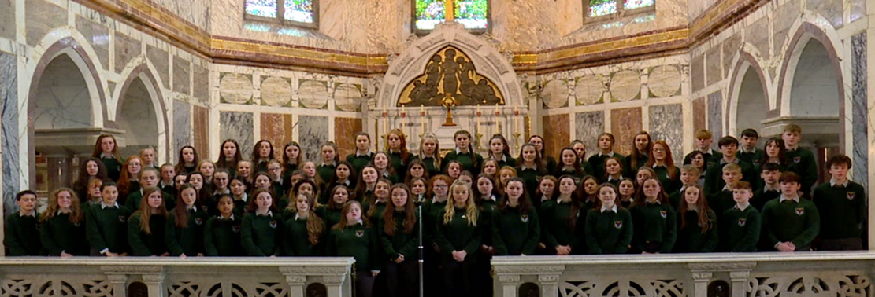
Welcome
1917: Founded by the Clonfert Sisters of Mercy
1974: Amalgamated with the St. Brendan’s De La Salle
CEIST
Thank you for choosing St. Raphael’s.

Slide 4
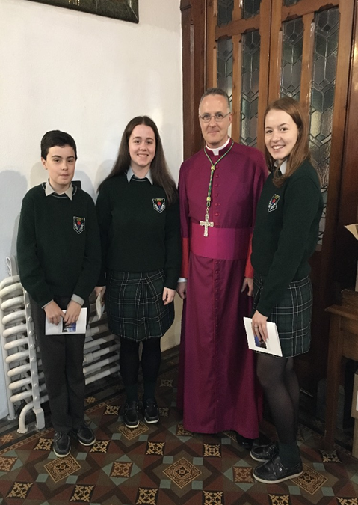
Parents' Handbook
Mission Statement (Page 1)
Board of Management (Page 2)
Pastoral Care (Page 4-5)
School Timetable (Page7)
Homework (Page 7)
Code of Behaviour (Page 19-25)

Slide 5
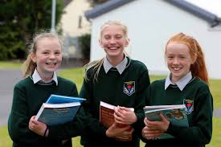
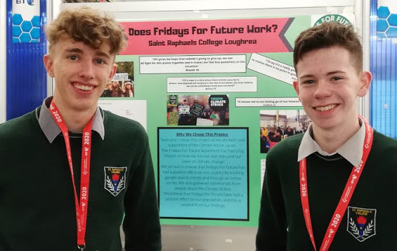
Transition from Primary to Secondary
New Beginning
New Challenges
Size – School - Classes
Movement to classrooms (teachers)
Timetable – 42 periods
Books
Lockers
Subjects
Increased workload
Integrating into School Life – New Friends

Slide 6
How we help manage the transition
Principal
Mr. Paul Cafferky
Deputy Principal
Mr. John Hardiman
Year Head
Mr. Sean Parr
Guidance Counsellor
Chaplain
Class Tutors
Cáirde Nua
Pastoral Care Team
Year Head – Mr. Parr
Class Tutors – scheduled weekly class time
Well-Being
Journals

Slide 7
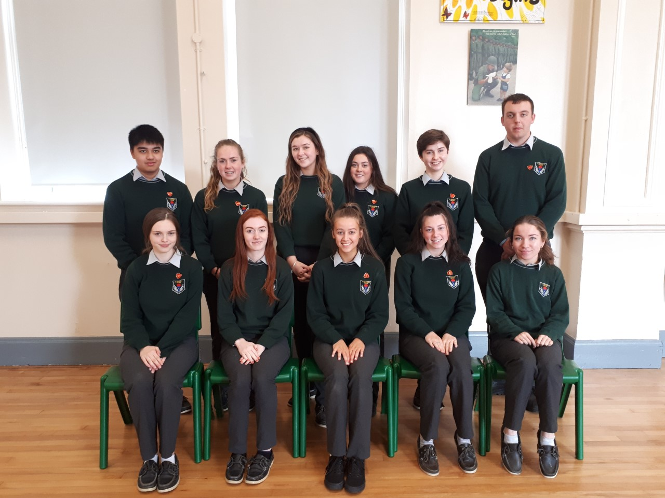
How we help manage the transition
Mentoring Programme – Cáirde Nua and Peer Mentors
Assist with the transition in the first few months
Support and Guidance
Lunchtime activities
Designated Lunchtime Area
Information Evenings for Parents
Themed Events – Anti-bullying/Friendship Week, Wellness, Healthy Eating, European Day of Languages etc.

Slide 8
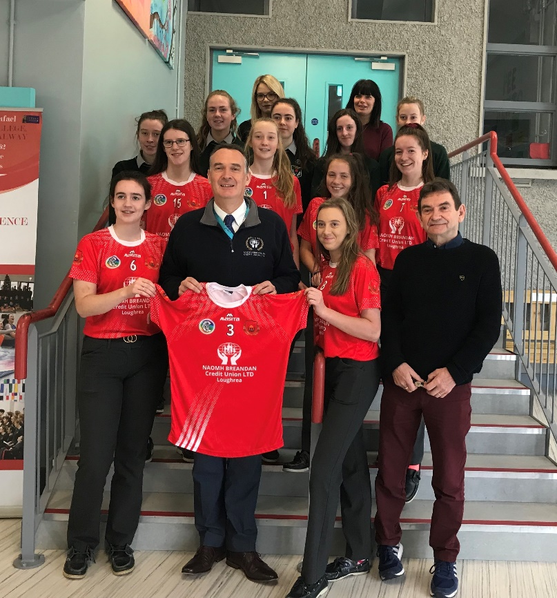
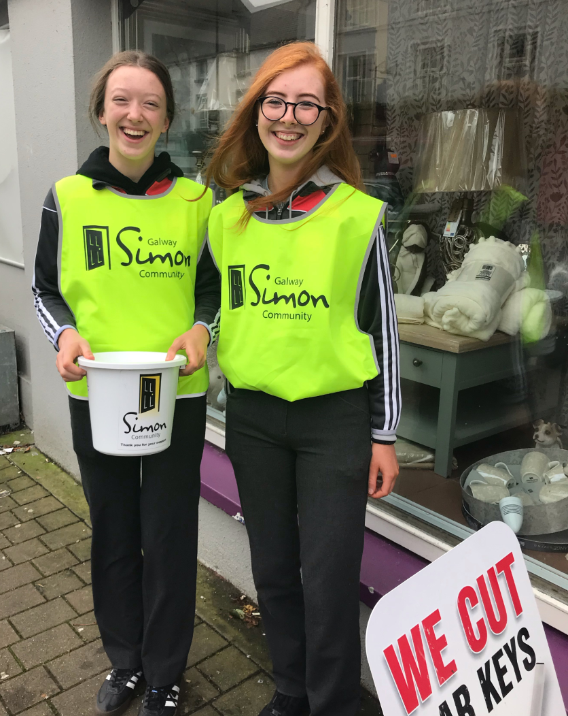
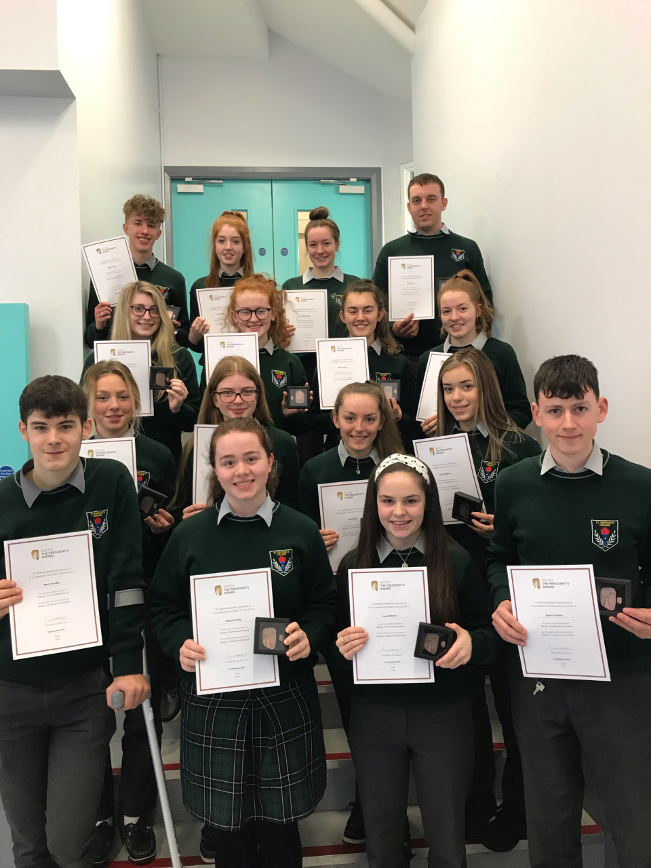
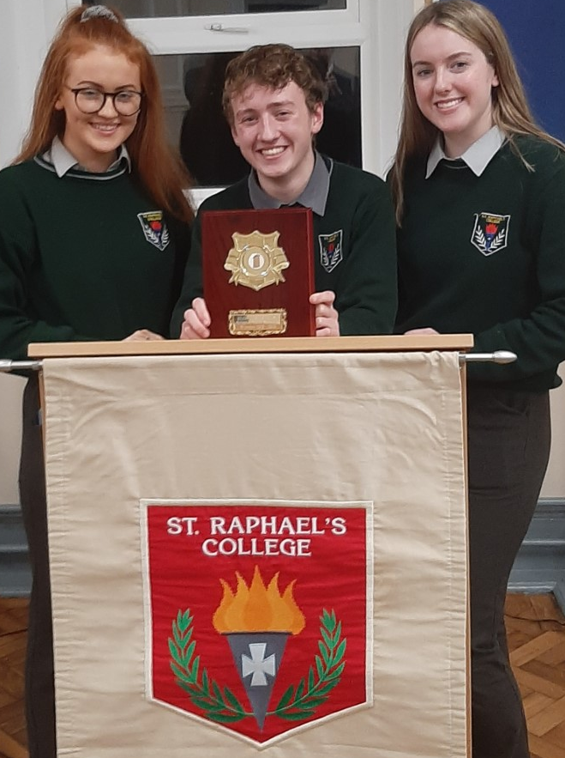
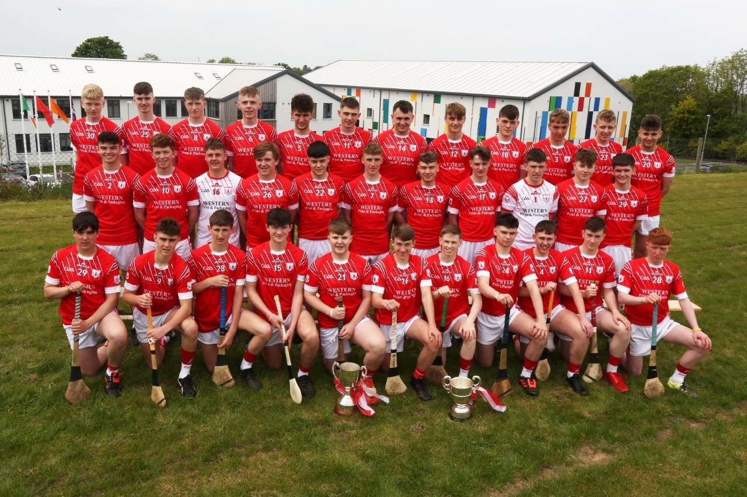
Extra-Curricular
Education is more than what happens in the classroom, St Raphael’s College seeks to provide a holistic educational experience for all its students.
We provide a wide range of extra-curricular activities.
This will inevitably allow students
to:
Develop new skills
Make new friends
Collaborate with their peers
Have fun

Slide 9
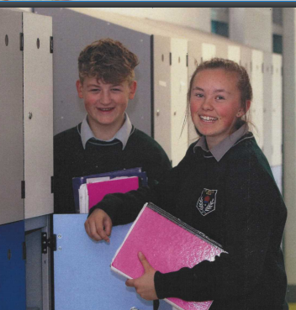
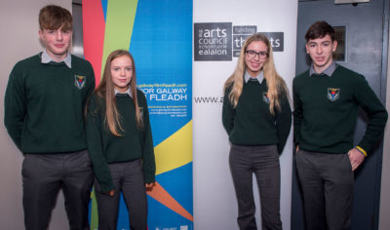
School Day
Time | Monday | Tuesday | Wednesday | Thursday | Friday
9:00-9:40
9:40-10:20
10:20-11:00
11.00-11.15 | B | R | E | A | K
11:15-11:55
11:55-12:35
12:35-1:15
1.15-1.55 | L | U | N | C | H
1:55-2:35
2:35-3:15
3:15-3:55
Timetable
Homework Club
Lockers
Uniform

Slide 10
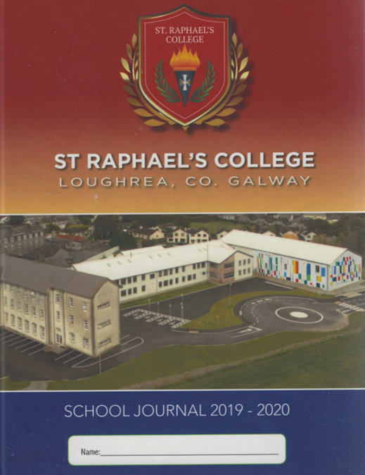
Home School Links
Regular contact between home and school is essential.
The main methods of communication are:
School Journal
School Reports
Parent/Teacher Meetings
Informal Meetings
Parent Education Programmes
Parents’ Handbook
Letters home to parents
Text messages

Slide 11
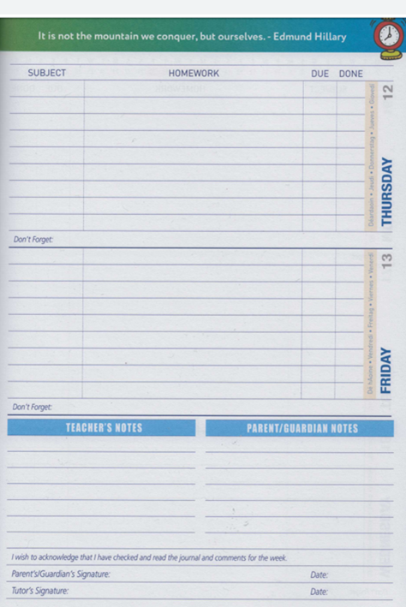
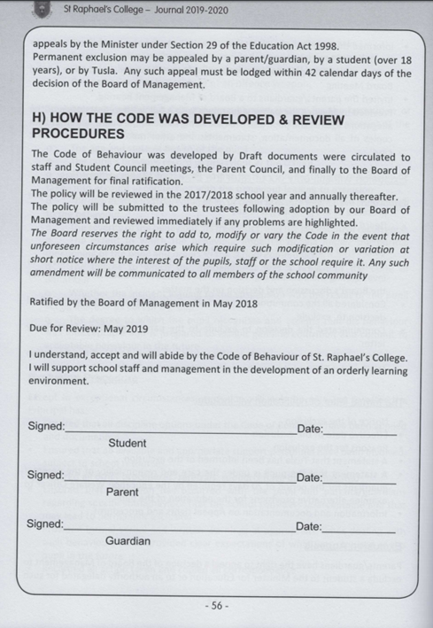
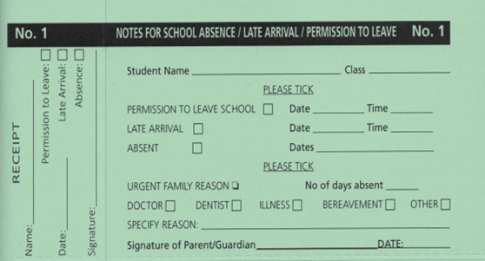
School Journal
Attendance
Appointments
Code of Behaviour

Slide 12
1st Year Subjects
New Junior Cycle
COMPULSORY
English | Irish | Maths | History
Geography | Science | Business Studies | French/German
OPTIONS
Home Economics | Art | Music
Technology | Materials Technology-Wood (MTW) | Technical Graphics
Some common things to know
English, Irish and Maths are core subjects, this means everyone studies these, they are not optional.
Science, Business, Geography and History will also be studied by all students.
Languages- students must study one of the following languages:
French
German
WELL-BEING
SPHE | CSPE | Wellbeing | Religious Education | Physical Education
Option Subjects:
We will do our best to give every student their top 2 subject preferences
Students will study 2 of these 6 subjects:
Home Economics
Music
Art
Materials Technology- Wood
Technical Graphics
Technology

Slide 13
HOME ECONOMICS
Home Economics is a subject that will provide your child with skills that will benefit them in every aspect of their life. Home Economics is a subject where you will learn how to take care of yourself, others, your home and your environment. As Home Economics is a very practical subject, you will carry out a lot of activities in school and at home.TV personality and Chef Neven Maguire is an ambassador, firm advocate and supporter of Home Economics in schools and its importance to all age groups.
What will I learn in Home Economics?
How to develop their food and health literacy skills and make positive lifestyle choices.
How to develop critical thinking and decision making skills, helping them live a sustainable, responsible life.
How to become competent consumers, managing financial resources within the home.
How to become more aware of our impact socially, economically and environmentally on the world around us.
How to promote and safeguard their Wellbeing.
How to be resilient and deal with life’s challenges and opportunities.
How to implement a design brief process and bring it from conception to realisation, in the areas of textiles and food.
How will I learn Home Economics in school?
Examining various diets, investigating the impact various foods have on our health. Personal reflection.
Designing menus and diets suitable for those with particular dietary disorders, implementing nutritional knowledge.
Internet and book research in groups and individually will play a big role in Home – Economics.
Development of practical cookery skills through the use of a design brief, working in pairs, carrying out a cookery assignment.
By evaluating work and corrections to problem solve a brief given.
Developing craft skills through practical application and making an item of choice.
Preparing and designing folders to accompany both cookery and textile projects.
How will Home Economics be useful to me?
Home Economics is a subject that will benefit you in every aspect of your life. A lifelong skill that you will learn and implement as you go through life.
Dietary knowledge, helping make wise food choices.
Knowledge of foods and their nutritional composition allowing us to make wise informed choices.
Learning basic cookery skills required to prepare, cook and serve various foods and dishes.
It will make use wise and sustainable consumers.
It will make us more aware of our general Wellbeing and Health and how to promote this in a positive way.
It will help us become more environmentally aware and sympathetic to our surroundings.
It will encourage us to use our artistic and creative talents to explore various crafts and develop new interests and hobbies.

Slide 14
How can I learn more about Home Economics outside of school?
Some of the things you may do are:
Cook dishes at home/ if you are eating out, take note of menus, prices, etc.
Use a library, magazines and the internet for information and ideas on food, household items and design.
Watch cookery and interior decoration programmes on television.
Look at fashion magazines for design ideas.
When shopping for clothes, look at the care labels and the type of fabrics used.
Will Home Economics have anything to do with other subjects I will be studying?
Because Home-Economics is such a broad and varied subject it will overlap with many other subjects a student will be studying at junior cycle level.
Nutritional elements will also be learnt in Science.
Human physiology will also be covered in Science.
Consumer studies will also be covered in Business.
Health and Wellbeing will be covered in SPHE and Wellbeing.
Sustainability will also be covered in Geography.
Creative skills and processes will overlap with the Art classes.
What is the Home Economics Junior Cycle exam like?
There are two parts to the exam:
Written exam: This is a common level paper which will be taken at the end of third year. It will examine theory completed over the three years involving the three strands studied:
Strand 1-Food, health and culinary skills.
Strand 2-Responsible family living.
Strand 3-Textiles and craft.
Coursework: This is made up of two CBA’s.
CBA 1 – Creative Textile Assessment. This CBA will be completed in 2nd year. A brief will be given to make a textile item suitable for an individual/home OR Recycle/upcycle a textile item foe an individual/home.
CBA 2 – Practical food skills exam. Food literacy skills briefs will be issued by the State Examinations Commission in 3rd year. Students will be required to investigate the brief and prepare, cook and serve a dish which fulfils the requirements of the brief.
Will Home Economics be very different after the Junior Cycle?
In Leaving Certificate Home Economics you will study the core areas in greater detail: Food Studies, Resource Management and Consumer Studies and Social Studies.
You will also choose to study an elective area:
Home Design and Management
Textiles, Fashion and Design
Social Studies.
There is also a food studies journal that is completed and is worth 20% of the overall Leaving Certificate result.
Is learning Home Economics anything like what I did in primary school?
In SPHE and SESE: Science you will have learnt about your body, how to care for it and the correct foods to eat. You will have made some items in Visual Arts which will be useful when you start sewing in class. You will have weighed and measured items and materials in Mathematics. You will have studied topics related to the family in SESE (History, Geography and Science).

Slide 15
MUSIC
Music is an important part of everyone’s life. In Junior Certificate Music, you will sing and possibly learn how to play an instrument. You will listen about many types of music such as pop, classical and traditional Irish music.
What will I learn in Music?
Some of the things you will learn include:
How to play the ukulele in class and play along with your favourite pop songs. We have 30 ukuleles in the music room.
How to read music notation.
How to compose your own music and songs with the use of the various instruments in our music room (over 25 different instruments for you to explore in class).
Be able to develop your music vocabulary to describe film music and the music that you listen to everyday.
Use various digital learning technologies and apps (garageband, drum genius, audacity etc) to enhance your learning experience and develop creativity. You can explore these digital devices to record your individual or group creations in order to share this content with each other and develop a portfolio of your work.
To develop your imagination in unique ways, through listening to familiar and unfamiliar works, coming to know and understand sounds internally, creating sound pictures or stories and expressing feelings and emotions in sound.
How will Music be useful to me?
Music has a very important part in many peoples’ lives. Most of us will take pleasure in listening to music and many people will enjoy singing or playing an instrument throughout their lives. Some people may even decide to take up a career in music in areas such as education (teacher, lecturer), business (sound engineer, lyricist, reviewer, therapist) and performance (composer, performer, conductor).
You will be able to read music notes.
You will learn the skill of playing an instrument.
You will be able to identify different genres of music and instruments by listening to a wide variety of music.
You will develop an appreciation of the role music plays in your culture and history.
You will get to know students in other years in the school through the choir which performs at school events.
How will I learn Music in school?
Some of the things you may do with your teacher and your classmates are:
Use communication skills to explore and express your emotions.
Perform or present in groups, actively rehearse together during class.
Sing, clap, dance and feel connected to others through participating in music activities and song.

Slide 16
How can I learn more about Music outside of school?
Some of the things you may do are:
Listen to music .
Sing along with new technology software and computer games.
Learn to play an instrument/Form a band with your friends.
Go to concerts and musicals.
Join a choir or local music group such as a brass band or a branch of Comhaltas Ceoltóirí Éireann
Will Music have anything to do with other subjects I will be studying?
Yes. You may learn songs in the modern languages you study. Also, you may use music in learning dance during Irish class and Physical Education. In English, you will study the importance of music in films and in advertisements. In Science, you will learn about sound which will help you better understand acoustics in Music. Technology will help you learn more about Music Technology. Music is also closely linked to Art and History.
What is the Music Junior Cycle exam like?
There are two parts to the exam:
Practical examination - this will occur in the March/April of third year. You will be asked to perform three pieces/songs of your choice on any combination of instrument or voice in either a group or solo setting. This exam is worth 30%.
Written examination – there will be a two hour common level written paper which entails listening, music theory and composing.
You can take the exam at Higher or at Ordinary level.
Will Music be very different after the Junior Cycle?
Junior Cycle music naturally graduates onto the Senior Cycle music course. All of the main elements remain; composing, listening and the performance. The practical exam is now worth 50% which is an amazing opportunity for you to gain points based on your musical performance.
Is learning Music anything like what I did in primary school?
The three strands of the music curriculum at primary level remain the same in secondary school; composing, listening and responding, and performing. You can continue to use the skills that you gained in primary school and develop your confidence in performing and collaborating with others in your class. In Music in primary school, you may have been part of a school choir and/or school music group or orchestra

Slide 17
ART
Art aims to develop the expressive, communicative and functional modes of art, craft and design in the individual within the art class with drawing as the central activity.
The study of Art at junior cycle aims to:
Develop self-confidence, inquisitiveness imagination and creativity.
Explore and develop their own ideas and to find personal expression through art, craft and design.
Use, research and experiment with a variety of traditional, contemporary, digital or new media.
Expand students knowledge and understanding of a range of Visual Art processes, skills and techniques.
Develop the visual literacy, critical skills and language necessary to engage with contemporary culture.
Look at, respond to and evaluate their own artwork and the artwork of others.
What will I learn in Art?
Some of the things you will learn include:
Investigate by looking and recording your observations and experiences.
Learn a variety of new crafts.
Learn to work in 3-D e.g. construction, sculpture or clay work.
Learn about the design process and how to use it to create new design objects and images.
Learn to make links between your artwork and that of other artists, craft workers, architects and designers from different countries and historical periods.
Drawing, painting skills , construction skills, paper mache, sculpture, ceramics , clay work, design work , graphics , lino printing .
How will I learn Art in school?
Some of the things you may do with your teacher and classmates are:
Learn art by research, looking at art works and creating art pieces.
Develop your observational skills through drawing and painting.
Use a variety of materials and resources (including ICT) and explore the different ways in which they can be used.
Learn how to plan, manage and complete your art works.
Try your best at homework and assignments.
How will Art be useful to me?
Many of the skills you learn while studying Art, Craft, Design are very useful outside of school and in whatever job you choose to do in the future. There are many career opportunities - areas such as: photography, cinematography, illustration, animator, interior/ industrial/ fashion design, product/graphic design, film/theatre/ costume design, web design
education, historian and architecture.

Slide 18
How can I learn more about Art outside of school?
Some of the things you may do are:
Look at and think about visual images from film, cartoons, books, billboards etc.
Keep a visual diary, where you will store knowledge, ideas, photographs, observations, etc.
Visit local and national art, craft, design centres and libraries.
Use the Internet, where you can find styles and types of art, craft and design from your own country and from other countries.
Will Art have anything to do with other subjects I will be studying?
Art, Craft, Design is all around you so it links with all subjects especially: Science – colour wheel, light, rainbow, colour mixing, Geography – landscapes, weather, Maths – Grid work, graphs, measuring, Religion – looking at religious paintings i.e. works from the renaissance. the art department does all the artwork for the school masses/ events in the school community, History - history of art, Home economics - Applique, creative embroidery, textiles, Woodwork – construction, sculpture, MTW– measuring and perspective, English – posters for the play they are studying/ illustrating a poem, calligraphy, cartoons about the novel / designing a book jacket about the novel.
What is the Art Junior Cycle exam like?
In Art, Craft, Design, you will be examined in two ways:
Course-work: in third year, you will do a school-based project, chosen from a list of themes. You will research your theme, do preparatory work and complete a painting or graphic design, a craft piece, and a 3-D piece. You will relate your work to other artist’s work.
An examination in which you will draw an object and a person.
You can take Art, Craft, Design at Higher or at Ordinary level. When the time comes to decide, your teacher will help you choose the level that suits you best.
How will Art be different after Junior Cert?
After the Junior Certificate, you may be able to choose Art as an option for your Leaving Certificate. You will continue to build on the artistic skills you developed in Junior Certificate, and you will be offered greater challenges. You will continue to study the history and appreciation of art, craft, design, and the built environment in a more formal way.
Art at Leaving Certificate includes both a project and an art history exam. 62.5% is awarded for the practical coursework to include life sketching, still life or abstract composition and design or craftwork and 37.5% of the marks are for a written exam on Art History. A new course begins in September.
Is learning Art anything like what I did in primary school?
You have already been expressing your creative abilities through drawing, paint and colour, print, clay, construction, fabric and fibre in primary school. You will continue to build on these skills and you will also learn to use other tools, materials and special equipment to create images and objects.

Slide 19
MATERIALS TECHNOLOGY- WOOD
Materials Technology Wood (MTW) is one of the technology subjects offered at Junior Cycle. In MTW you will learn to design small projects and the skills required to use tools and equipment to make your designs. You will work mainly with wood but also with other materials. You will learn about wood as a material and how it is produced.
What will I learn in MTW?
Some of the things you will learn include:
How to design a project given a brief description of what you are to make.
how to use the internet for research purposes.
How to use freehand sketching to communicate your ideas.
How to prepare a design drawing/plan of a project you design.
How to read design drawings and make small projects from these drawings.
How to safely use arrange of hand and power tools in producing your design.
How will I learn MTW in school?
Some of the things you may do with your teacher and your classmates are:
Examine trees, their leaves and seeds and be able to recognise their varying characteristics.
Investigate how trees affect the environment around us.
Learn to sketch freehand.
Learn how to problem solve and use a design process to design projects.
Develop your craft skills to allow you to make projects.
Prepare a design folder to accompany your project.
How will MTW be useful to me?
You will know the correct procedures to follow when developing an idea into a finished artefact e.g. a piece of furniture or a child’s toy etc.
You will be able to identify different trees, recognise their importance to us and our environment
You will also have the skills to make objects from wood and know how to apply appropriate finishes to them, e.g. paint, varnish, stain or polish.

Slide 20
How can I learn more about MTW outside of school?
Some of the things you may do are:
Rather than just looking at trees, try to recognise the different species and their features.
Examine how pieces of furniture are put together and why they are so strong.
Use the internet to find information on design, wood, plastics and woodworking skills.
Talk to people involved in the woodworking industry, for example carpenters or cabinet makers.
Will MTW have anything to do with other subjects I will be studying?
Yes. Materials Technology Wood will be useful to you in the study of any of the other three technology subjects, Technical Graphics and Technology. Many of the skills involved in this subject are also used in the other subjects. MTW is also related to some of the topics covered in Science and Art.
What is the MTW Junior Cycle exam like?
There are two parts to the exam:
Coursework – you will design a project based on a given design brief (instructions). You will then make the project and prepare a project folder to accompany it (66%).
Written examination – there will be a two hour written paper which examines the woodwork theory you have learned over the three years (33%).
You can take the exam at Higher or at Ordinary level. When the time comes to decide, your teacher will help you choose the level that suits you best.
Will MTW be very different after the Junior Cycle?
MTW develops into Construction Studies in senior cycle. In this subject:
The emphasis is on the principles behind building and construction
There is a large amount of practical work involved in the course
Drawing skills learned in MTW will be further developed.
Is learning MTW anything like what I did in primary school?
You will be building upon the drawing work you did in Visual Arts. You may already have learned a lot about wood as a material as part of your work in Science. You may also have learned about trees as part of the natural environment and as a habitat in both Geography and Science. The skills you developed when designing and making things in Science will also be very helpful in MTW. You will also use your mathematical skills quite a lot.

Slide 21
TECHNICAL GRAPHICS
Technical Graphics (Graphics) is one of the technology subjects offered at Junior Cycle. Technical Graphics deals with one’s ability to interpret visual data and the learning within Graphics and Design and Communication graphics at senior cycle will greatly enhance the learner’s ability to analyse and interpret this information.
The study of Technical Graphics at junior cycle aims to:
Develop the student’s creativity, spatial ability, and capacity to reason and
communicate ideas through engagement with abstract and applied geometric.
Problem-solving activities.
Encourage the development of the cognitive and practical dexterity skills associated
with graphical communication.
Instil an appreciation of the role of graphics in the world around them.
Equip all students to make judgements on the best mode through which represent
their ideas and solutions.
Encourage the production of drawings that promotes the skills of communicating through graphics.
Develop students cognitive and practical skills associated with modelling and graphical communication.
What will I learn in Technical Graphics?
Some of the things you will learn include:
Learn about and how to use drawing equipment.
How to produce two–dimensional and three-dimensional drawings using drawing equipment.
How to create freehand sketches.
How to create 2D and 3D drawings on a computer.
How to read and understand drawings and diagrams.
The influence of Graphics on the design and manufacture of products.
How will I learn Technical Graphics in school?
Some of the things you may do with your teacher and your classmates are:
Draw 2-dimensional and 3-dimensional drawings using the drawing equipment.
Learn how to problem solve to reinforce learning.
Use freehand sketching, colouring and shading to represent objects.
Work on your own and as part of a group.
Use a textbook and worksheets.
Organise and maintain a folder of drawings and notes.
Work on the Class computers on the ‘Solidworks’ software to design and model project work.
How will Technical Graphics be useful to me?
Graphics will develop the Students Visualisation, Design thinking, Communicating and Geometric principles and constructions. Graphics helps you to think in a more logical and creative way. You will learn how to present information in a neat and organised fashion. These skills will be necessary to study Design and Communication Graphics in Senior Cycle.
Many Careers leading on from Graphics and from D.C.G. at senior cycle are:
Construction, Architecture, Quantity Surveying, All types of Engineering, Interior Design, Product Design, Computer Coding, Graphic Design, Fashion Design, Computer Game Design and all types of trades.

Slide 22
How can I learn more about Technical Graphics outside of school?
Some of the things you may do are:
Become aware of how graphic communication is all around us, in the print media, and on television. Watch TV programmes or YouTube clips on building and house design, for example ‘Room to Improve’, ‘Grand Designs’.
Examine how goods are packaged to see how the skills learned in Technical Graphics can be put to best use.
Use the internet to find examples of graphic illustration and computer aided design.
Be alert to examples of shape in nature and in the design of everyday objects, buildings, bridges etc.
Will Technical Graphics have anything to do with other subjects I will be studying?
Yes. Technical Graphics will be useful to you in the study of any of the other two technology subjects, Wood Technology and Technology. Many of the skills involved in this subject are also used in the other subjects. Graphics is also related to some of the topics covered in Science and Art/Craft/Design.
More specifically, the subject Technical Graphics has a strong relationship with the Leaving Certificate subject, Design and Communication Graphics. The learning outcomes to be achieved in the Graphics specification provide a strong foundation of the knowledge required for the study of Design and Communication Graphics.
What is the Technical Graphics Junior Cycle exam like?
The assessment of Technical Graphics for the purposes of the Junior Cycle Profile of Achievement (JCPA) will comprise of:
• two Classroom-Based Assessments; (2nd Year and 3rd Year)
(Communicating through sketching and Graphical presentation skills)
• a project
• a final examination.
Final Assessment: Project 30%
This project will be completed within a four-week window in term two of third year.
Final examination 70%
Two-hour examination set and marked by the State Examinations Commission.
Will Technical Graphics be very different after the Junior Cycle?
As mentioned earlier the subject Technical Graphics has a strong relationship with the Leaving Certificate subject, Design and Communication Graphics. D.C.G. also has coursework where the students produce a project worth 40% for the Leaving Cert’. This is a subject that equips the students for many opportunities in third level education. It should be pointed out, that it would be important to have done Technical Graphics at junior cycle to have the pre-requisite knowledge necessary for D.C.G. at senior cycle.
Is learning Graphics anything like what I did in primary school?
Junior Cycle Technical Graphics can progress related learning that has taken place at primary level. A number of subjects in the primary curriculum such as Science, Mathematics and Visual Arts refer to the development of problem solving skills, which are key skills for a student of Graphics. Throughout their years at primary school, students engage in various activities that develop their creativity, which lends itself directly to the study of Technical Graphics.
Other Information: To get an overview of how the subject ‘Graphics’ is perceived by industry please open the link below to get the views of Dermot Bannon (Architect) https://www.youtube.com/watch?time_continue=27&v=4263Mj1DWzw&feature=emb_logo

Slide 23
TECHNOLOGY
Technology is mainly about using a design process to solve technological problems. In Technology, you will use the design process to work through a task or problem in order to arrive at a solution, which is usually in the form of an artefact or finished product. You will learn how to safely use the tools, materials and equipment necessary to make this product.
The study of Technology at junior cycle aims to:
Enable students to develop the necessary conceptual understanding, disciplinary skills and subject knowledge to investigate and solve real-life problems.
Promote the enjoyment of the study of the subject while developing a curiosity about the technological world,
Develop the ability of students to generate and evolve their ideas through an interactive process and communicate through appropriate media.
Develop students’ resilience through constructive critique and support their learning in a ‘safe failure’ environment.
Encourage a disposition of enquiry, innovation, creativity, and self-efficacy.
What will I learn in Technology?
Some of the things you will learn include:
an understanding and appreciation of design and the design process
how to use the tools and equipment necessary to complete projects in a safe manner
an understanding of different materials, their properties and how best to work with these materials, i.e. wood, metals and plastics
how to use electronic components to build simple circuits for use in tasks and projects e.g. running mechanical toys.
How will I learn Technology in school?
Some of the things you may do with your teacher and your classmates are:
investigate the role of technology in the world we live in
use tools and equipment in a safe manner
learn how to identify a range of different materials and their properties
use the design process to find a technological solution to a problem
communicate your ideas using sketches and design drawings
learn about mechanisms such as gears and how they work.
How will Technology be useful to me?
Technology will help you to solve many technological problems you may experience in your every day life. This subject teaches you to think about a problem and then use your knowledge and skills to design a solution to that problem. It will also teach you skills in the use of basic tools and equipment. You will also be able to identify many different types of materials and have a basic understanding of electronic circuits and gear systems.

Slide 24
Will Technology have anything to do with other subjects I will be studying?
Yes. Technology is closely related to the other three technology subjects; Materials Technology Wood, Metalwork and Technical Graphics. All the technology subjects involve practical skills, drawing skills and theory. Junior Cert. Science and Home Economics also have links with Technology.
What is the Technology Junior Cycle exam like?
Technology is assessed at a common level. On completion of the Classroom-Based
Assessments, students undertake a project. The project is completed after the second CBA in third year. The brief for the project is set and marked by the State Examinations Commission (SEC). The project accounts for 70% of the final SEC grade with the written examination accounting for the other 30%.
Will Technology be very different after the Junior Cycle?
Leaving Certificate Technology follows on from Junior Certificate Technology and has been introduced in some schools. It builds on many of the topics covered in Junior Cycle and deals with them in a much more detailed way. Project work is also part of these examinations at Leaving Certificate level.
Is learning Technology anything like what I did in primary school?
In Junior Cycle Technology you will build upon some of the work you did in Maths in primary school, i.e. in Technology you will be working out problems and reading measurements on drawings. You will also be able to use many of the things you learned in Science in primary school. For example, you will have learned about various materials and where they are used. You will also have designed and made things in order to solve problems. All this learning will be useful in Technology.

Slide 25
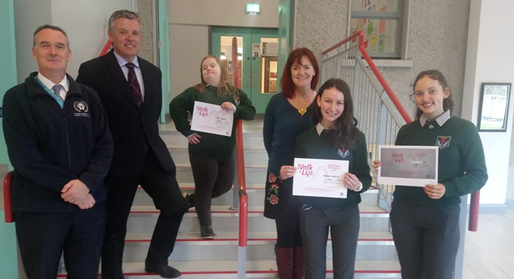
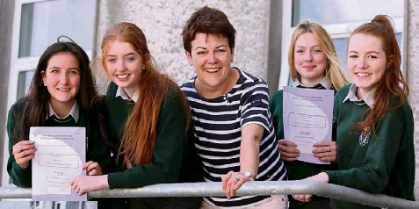
How to Choose?
While there is no ‘easy’ subject at second level, there are many benefits to each subject on offer.
It is important to do some research on each subject.
Speak to older siblings or family members about their subject choices.
When you choose your subjects try and plan to your strengths … Ask yourself:
What are you good at?
How do you like to learn?
Are you more practical for example, or artistic or musical?
If you enjoy a subject, you will be happy to spend time and energy studying it and perfecting it.

Slide 26
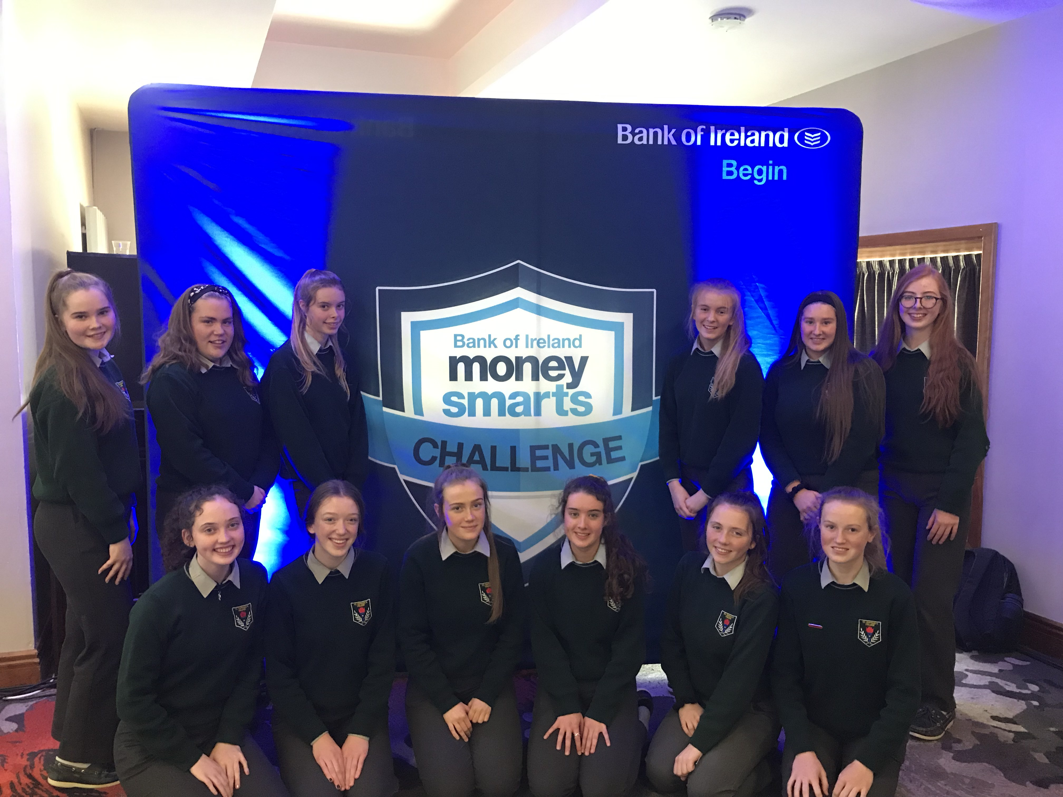
1st Year Subject Choice 2020
Please take some time to read the above information, discuss the subject options together and decide what subjects will be chosen for Junior Cycle.
While currently, we are unable to meet you in person, if you have any questions or queries with the subject options please email me john.hardiman@saintraphaels.ie and I will be happy to help you.
Complete the Subject Choice form- Closing date: Friday 19th June by post/by email.

Slide 27
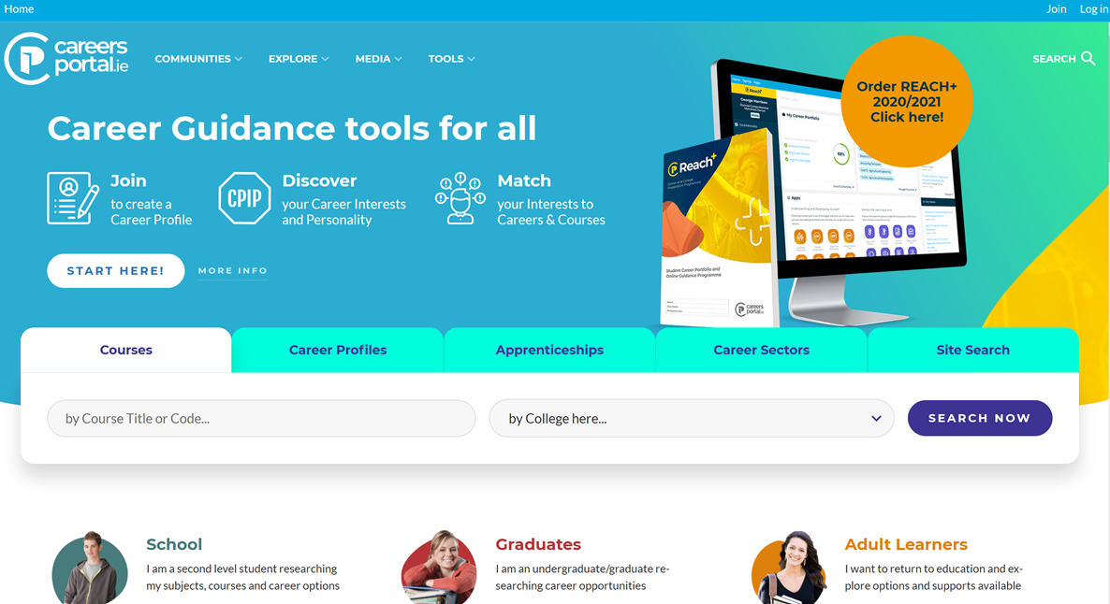
How to Research Subjects using Careers Portal
Log onto www.careersportal.ie
Click on School

Slide 28
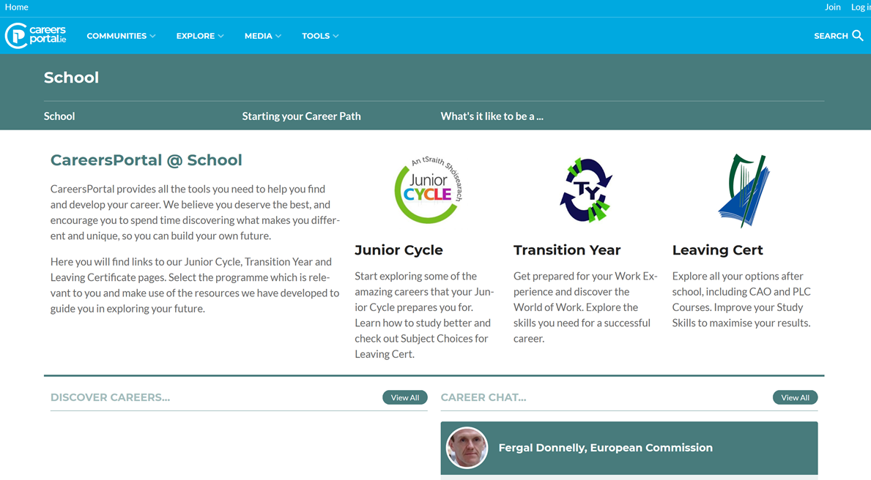
How to Research Subjects using Careers Portal
Then click on ‘Junior Cycle’

Slide 29
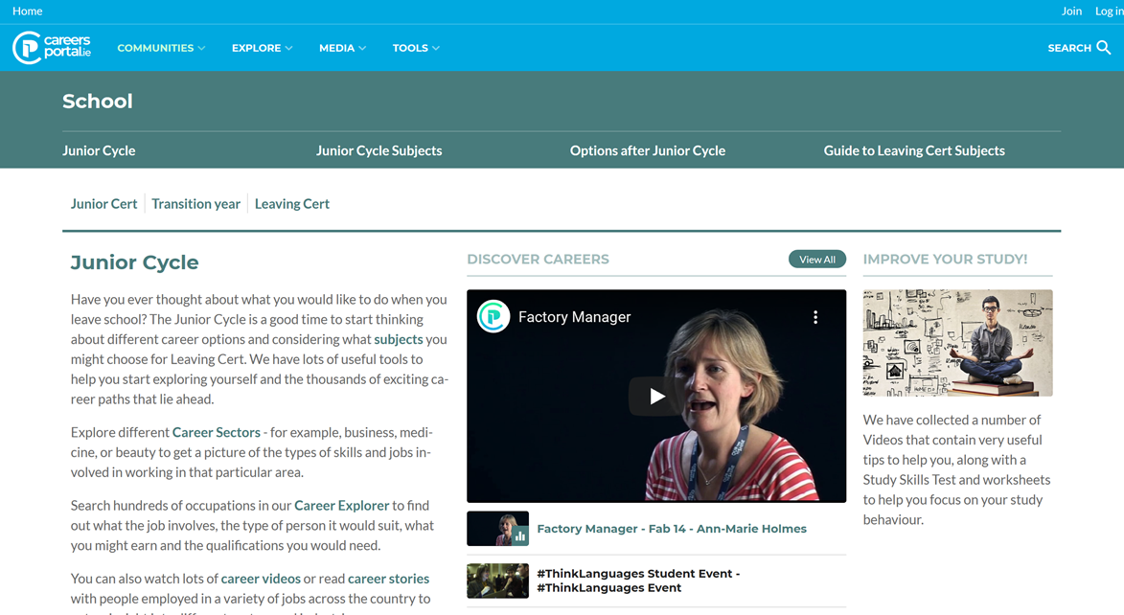
How to Research Subjects using Careers Portal
Click on ‘Junior Cycle Subjects’

Slide 30
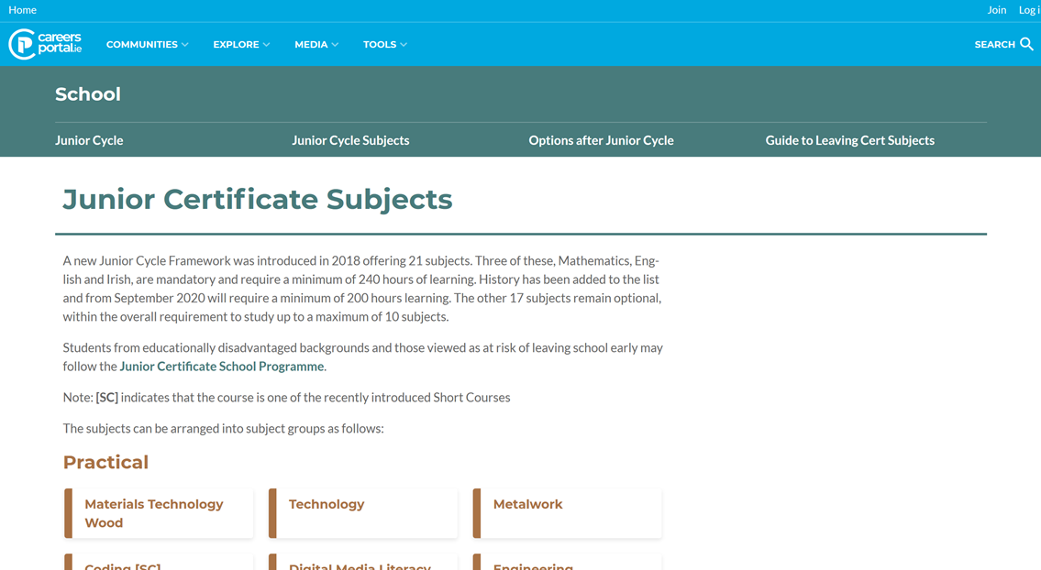
How to Research Subjects using Careers Portal
Here you will find every subject available for Junior Cycle in Ireland
If you click on any subject you can see all the information on that subject, including access to the full curriculum.

Slide 31
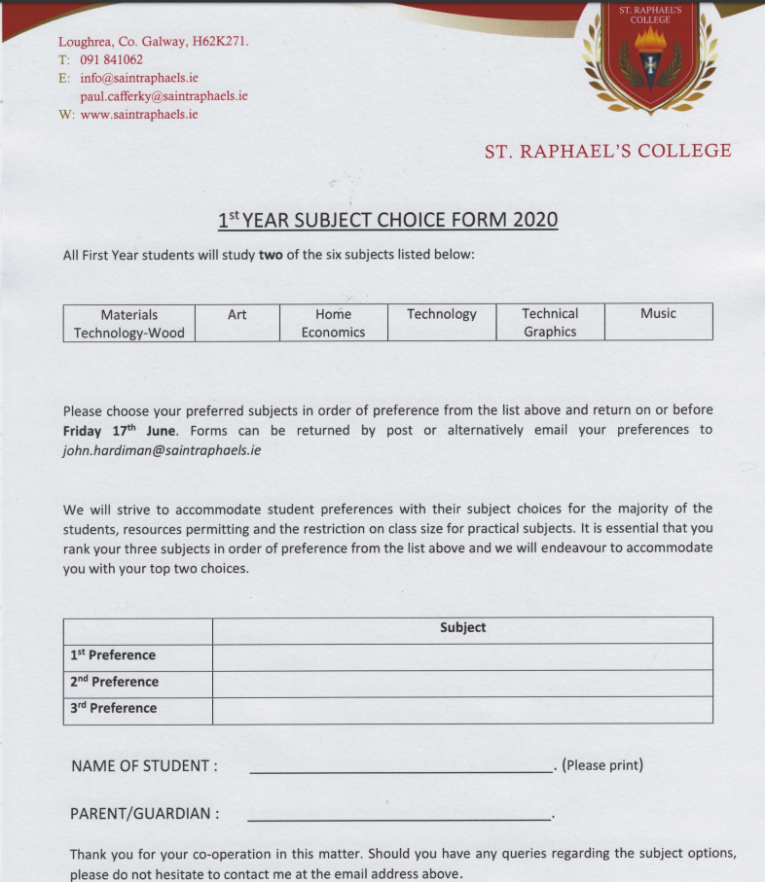
Next Steps
Choose your 1st, 2nd and 3rd subject preferences from
the option subjects – Home Economics, Music, Art,
Materials Technology- Wood, Technical Graphics or
Technology. (We will strive to accommodate each student
with their top two preferences).
Complete the Subject Choice form and return it to
Mr. Hardiman by post/email
john.hardiman@saintraphaels.ie by Friday 19th June.

Slide 32
Questions and Answers
In the Chat section of Zoom, please type any questions or queries that you may have

Slide 33
Conclusion

